Slide 1
Topics to be covered
Basics of Counting
Tree Diagrams
Lexicographic Order

Slide 2
Tree Diagrams
Counting problems can be solved using Tree Diagrams.
[A tree consists of a root, and a number of branches leaving the root or other branches. Leaves are at the end of branches.]
[Trees are studied in Week 11.]

Slide 3
Tree Diagrams
To use Tree Diagrams in Counting
A branch represents each possible choice
A leaf represents a possible outcome. Leaves are the endpoints of branches not having other branches starting at them.
N.B.
The number of choices required to reach a leaf can vary. The solution still remains the number of leaves.

Slide 4
Example 1 - Tree Diagrams
A playoff between two teams consists of at most five games. The first team that wins three games wins the playoff.
In how many different ways can the playoffs occur?
Solution (without using Tree Diagrams)
Ans. (⁵C₃ x 1 x 1)x2 or
5!/3!(5-3)! x2 or 20

Slide 5
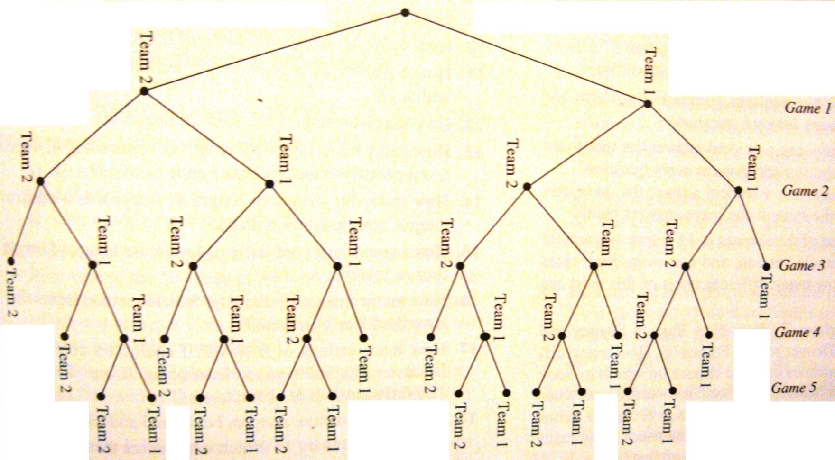
Example 1 - Tree Diagrams
Solution (using Tree Diagrams)
Ans. 20 (based on the number of leaves)

Slide 6
Example 2 - Tree Diagrams
How many bit strings of length four do not have consecutive 1s?
Solution (without using Tree Diagrams):
Total no. of bit strings of length 4 LESS
No. of bit strings that have consecutive 1s
(Consider 1s in positions 1-2, 2-3 & 3-4)
Ans. 2⁴ – (4+4+4-2-2-1+1)
or 16 – 8 = 8

Slide 7
Example 2 - Tree Diagrams
Solution (using Tree Diagrams)
Ans. 8 (based on the number of leaves)
1
0
1st bit
0
1
0
2nd bit
1
0
0
1
0
3rd bit
0
1
0
1
0
0
1
0
4th bit
1010
1001
1000
0101
0100
0010
0001
0000

Slide 8
Lexicographic Order
Lexicographic order generalizes ordinary dictionary order.
Given two distinct words, to determine whether one precedes the other, there are two (2) possibilities…

Slide 9
Lexicographic Order
The two (2) possibilities are
  The words have different lengths AND
  Each letter in the shorter word is identical to the corresponding letter in the longer word
    E.g. “dog” and “ doghouse”
  The words have same or different lengths AND
  At some position, the letters in the word differ
    E.g. “gladiator” and “gladiolus”

Slide 10
Lexicographic Order
Lexicographic order generalizes ordinary dictionary order
by replacing the alphabet with any set of symbols on which an order has been defined.

Slide 11
Definition - Lexicographic Order
Let α = s₁s₂…s_{p} and β = t₁t₂…t_{q} be strings over {1, 2, …, n}.
We say that
α is lexicographically less than β and write α < β if either
  p < q and s_{i} = t_{i} for i = 1, …, p
    Same e.g. “dog” and “ doghouse”
  for some i, s_{i} ≠ t_{i} and for the smallest such i, we have s_{i} < t_{i}
    Same e.g. “gladiator” and “gladiolus”

Slide 12
Example 1 - Lexicographic Order
Let α = 576 and β = 5768 be strings over {5, 6, 7, 8}.
Definition (a):
  p < q and s_{i} = t_{i} for i = 1, …, p
  Result:
  p = 3, q = 4
  s₁ = 5, s₂ = 7, s₃ = 6, t₁ = 5, t₂ = 7, t₃ = 6, t₄ = 8
  Since p < q and s_{i} = t_{i} for i = 1, …, p
  Therefore by definition (a) α < β

Slide 13
Example 2 - Lexicographic Order
Let α = 57689 and β = 5786 be strings over {5, 6, 7, 8, 9}.
Definition (b):
  for some i, s_{i} ≠ t_{i} and for the smallest such i, we have s_{i} < t_{i}
  Result:
  p = 5, q = 4
  s₁ = 5,s₂ = 7,s₃ = 6,s₄ = 8,s₅ = 9, t₁ = 5,t₂ = 7,t₃ = 8,t₄ = 6
  The smallest i for which s_{i} ≠ t_{i} is i=3
  Since s₃ < t₃ , by definition (b) α < β

Slide 14
Topics covered
Basics of Counting
Tree Diagrams
Lexicographic Order

